Slide 1
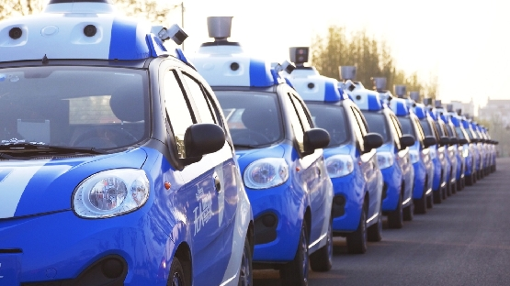

VDP1 MEETING PRESENTATION
BY JINGYU CHEN
PICTURES SUPPORTTED BY

Slide 2
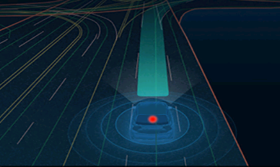
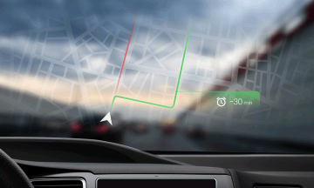
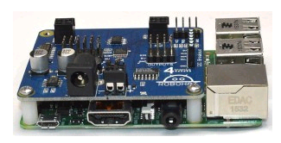
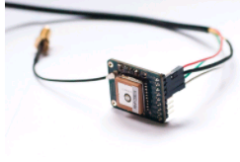
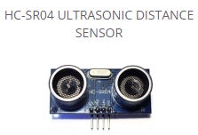
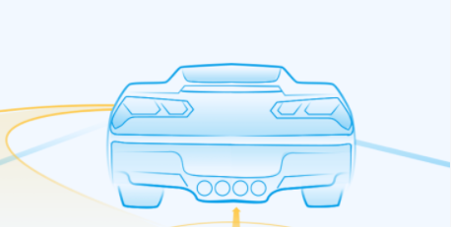
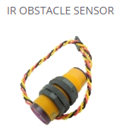
Ability of our Vehicle
Obstacle Avoidance
Micro control unit
Map Visualization
Sensors
GPS module
Ultrasonic
Infrared
Camera
line sensors
Line following

Slide 3
System structure
sensors
Micro control unit
motor drive
servo drive
power unit

Slide 4
obstacle avoidance
Ultrasonic
Lidar
Infrared
machine visualization
radar
Proximity

Slide 5
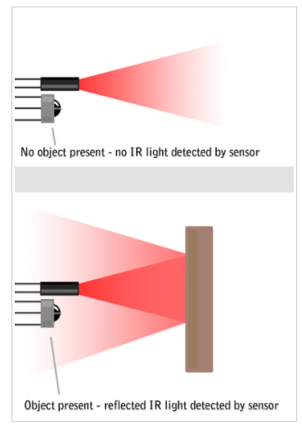
What we are planning to use ?
1. Infrared sensor
IR Sensors work by using a specific light sensor to detect a select light wavelength in the Infra-Red (IR) spectrum. By using an LED which produces light at the same wavelength as what the sensor is looking for, you can look at the intensity of the received light. When an object is close to the sensor, the light from the LED bounces off the object and into the light sensor. This results in a large jump in the intensity, which we already know can be detected using a threshold.

Slide 6
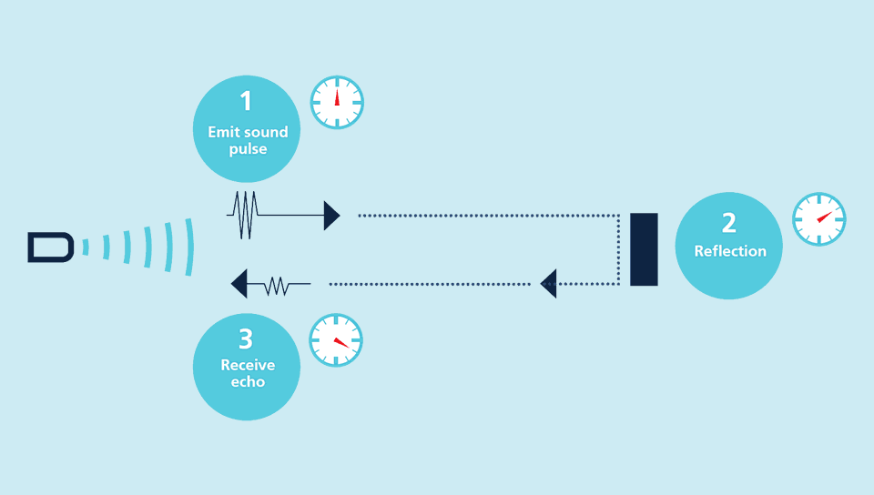
2. Ultrasonic sensor
Ultrasonic sensors emit short, high-frequency sound pulses at regular intervals. These propagate in the air at the velocity of sound. If they strike an object, then they are reflected back as echo signals to the sensor, which itself computes the distance to the target based on the time-span between emitting the signal and receiving the echo.

Slide 7
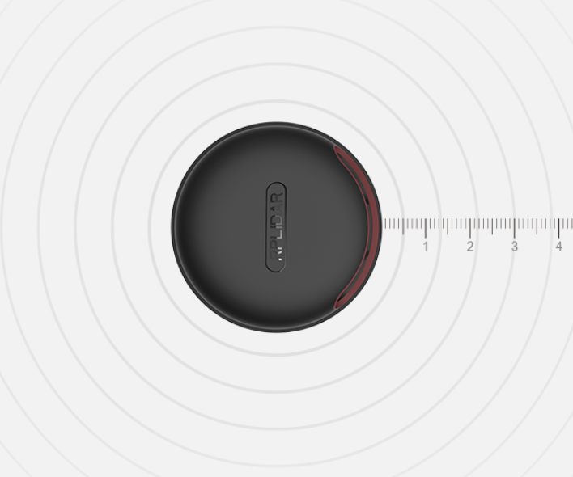
What we are still considering ?
+ slam algorithm
Consumer Lidar

Slide 8
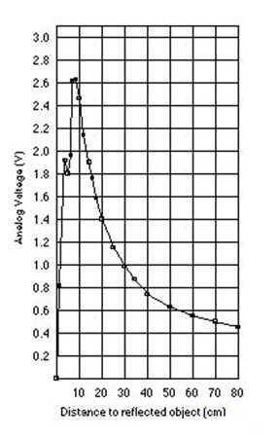
Pros and cons
precision
Temperature
Sunshine
Wind
Color of materials
Surface
Distance

Slide 9
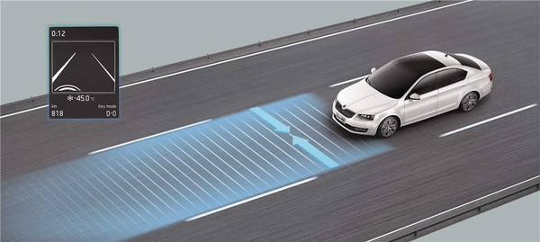
Model of testing road
Requirements:
1.Our vehicle is able to detect the line and follow the lane when it is driving on the road.
2. When it meets obstacles on the road, it should change the other lane immediately to avoid collision.
our vehicle will be tested
on a two-lane road

Slide 10
Algorithm
Based on the ultrasonic and infrared
Based on the Camera
We can use infrared sensors to follow the line and ultrasonic sensors for the obstacle avoidance.
Using PID control or Fuzzy control.
Neural Networks: CNN(Convolution Neural Network) or BP(Back-Propagation networks)
Opencv library will be called when trainning the data.

Slide 11
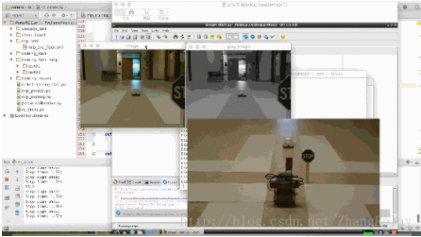
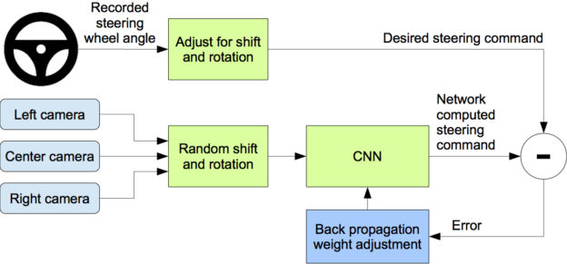
What we need to do is :
Use keyboard to control the vehicle(for testing ).
Collect pictures taking from a camera and return the picture matrix.
Using keyboard again to control the vehicle for collecting the training data.
Neural network training.
Testing the algorithm.

Slide 12
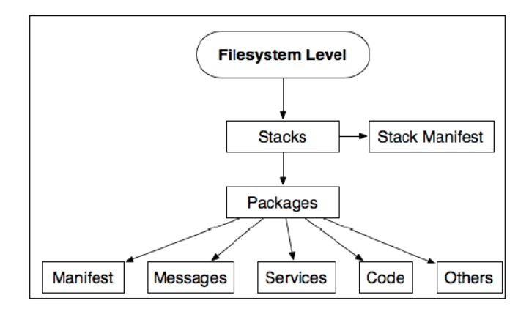
ROBOT OPERATING SYSTEM(ROS)
ROS is a flexible framework for writing robot software. It is a collection of tools, libraries, and conventions that aim to simplify the task of creating complex and robust robot behavior across a wide variety of robotic platforms.

Slide 13
Our question about ROS :
Is it completely compatible for Rpi?
Is it really valuable for us to use it on Rpi?
Is there any requirements for sensors operating on ROS?
Is there any cheap hardwares (meet our budget) supporting ROS we can use on Rpi to achieve some functions of the Autonomous Car?

